Slide 1
IBM University Engagement Project Submission
“Exploring the Power of Agentic AI with IBM Granite and LangFlow”

Slide 2

Project Tile – [ Fitness Buddy AI]
Domain of Project – [ Healthcare ]
Student Name | Recent Passport Photo | Email ID | Mobile number [WhatsApp]
B.Rekha sree |  | rekhasree4545@gmail.com | 9491262846

Slide 3
Problem Statement -
Problem Statement : Fitness Buddy AI
The Challenge
In today’s fast-paced world, many individuals struggle to maintain a healthy lifestyle due
to lack of personalized guidance, time constraints, and inconsistent motivation. Traditional fitness
solutions often require expensive subscriptions, in-person consultations, or rigid schedules that don't
adapt to personal preferences or daily routines.
There is a growing need for an accessible, friendly, and intelligent virtual assistant that can provide on-
demand fitness advice, healthy lifestyle suggestions, and basic nutrition guidance—all tailored to
individual needs and available at any time.
The Objective
The objective of Fitness Buddy AI is to provide users with personalized fitness guidance, workout recommendations, nutrition suggestions, and progress tracking through an intelligent AI-powered assistant.
The solution aims to:
Generate personalized workout plans based on age, weight, fitness level, and goals.
Provide real-time fitness coaching and motivation.
Track daily activities, calories burned, and workout performance.
Recommend healthy meal suggestions aligned with fitness goals.
Monitor progress and adapt plans dynamically.
Help users maintain consistency and achieve long-term fitness goals.

Slide 4
Technology Used
Tech Stack (Mandatory)
Use any one of the following approaches:
LangFlow + IBM watsonx.ai + Granite Models
IBM Cloud Agentic Lab with IBM Granite Models
Replicate with LangChain + RAG + IBM Granite Models
I used LangFlow + IBM watsonx.ai + Granite Models

Slide 5
Proposed Solution -
Fitness Buddy AI is an Agentic AI-powered fitness assistant built using LangFlow, IBM watsonx.ai, and Granite Models.
The system uses multiple intelligent agents working together to provide a complete fitness experience.
Key Features:
Personalized workout generation
AI-based fitness coaching
Nutrition recommendations
Daily activity tracking
Goal monitoring and progress analysis
Motivational feedback and reminders
Real-time fitness Q&A assistant
Core Agents:
1. Fitness Knowledge Agent
Retrieves workout information, exercise techniques, and fitness best practices using RAG.
2. Workout Planner Agent
Creates personalized workout routines based on user goals such as weight loss, muscle gain, endurance, or general fitness.
3. Nutrition Advisor Agent
Provides meal recommendations, calorie guidance, and hydration suggestions.
4. Progress Tracking Agent
Tracks completed workouts, calories burned, and fitness improvements.
5. Motivation & Wellness Agent
Provides reminders, encouragement, recovery tips, and healthy lifestyle recommendations.

Slide 6
Langflow component Used -
1.Chat Input
Collects user fitness goals, workout preferences, and health information.
Serves as the primary interaction point between the user and the AI system.
2. Prompt Template
Structures user input into optimized prompts for IBM Granite Models.
Ensures consistent and accurate AI responses.
3. IBM watsonx AI Agent
Processes user requests and coordinates multiple fitness-related tasks.
Acts as the central intelligence layer of the system.
4. IBM Granite-4.0-8B-Instruct Model
Generates workout plans, nutrition recommendations, fitness explanations, and motivational guidance.
Provides reasoning and personalization capabalities.
5. RAG Retriever
Retrieves fitness, exercise, and nutrition information from trusted knowledge sources.
Enhances accuracy and reliability of responses.
6. Vector Database (FAISS / ChromaDB)
Stores embeddings of fitness knowledge and workout resources.
Enables fast semantic search and information retrieval.
7. Memory Component
Maintains user context such as fitness goals, previous workouts, and progress history.
Supports personalized and continuous interactions.

Slide 7
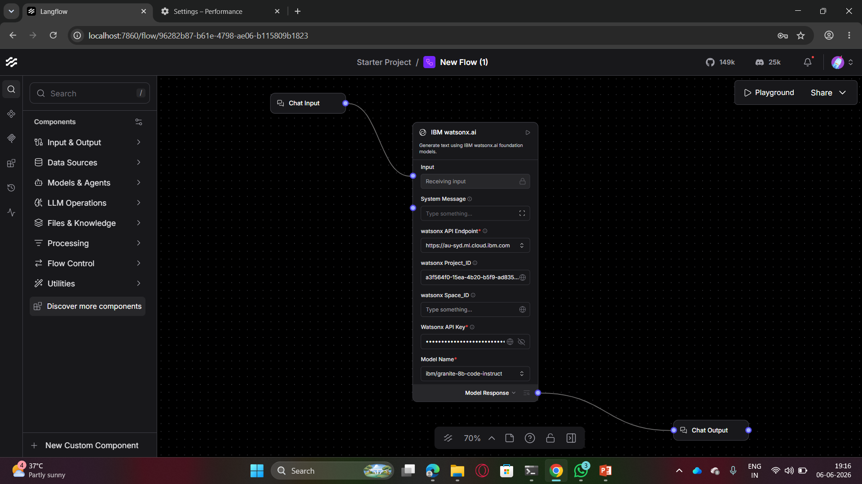
Langflow workflow -

Slide 8
Architecture blueprint
User
│
▼
Chat Input Interface
│
▼
IBM Granite Model
│
┌─────────┼─────────┐
▼ ▼ ▼
Fitness Workout Nutrition
Knowledge Planner Advisor
Agent Agent Agent
└─────────┼─────────┘
▼
Progress Tracking
Agent
│
▼
Personalized Response
│
▼
User Dashboard

Slide 9

Role of Agentic AI in the solution
Agentic AI enables Fitness Buddy AI to act as an intelligent personal trainer rather than a simple chatbot.
How Agentic AI Helps
Breaks complex fitness tasks into specialized agents.
Enables collaboration between workout, nutrition, and progress-tracking agents.
Understands user goals and context.
Continuously adapts recommendations based on performance.
Provides proactive suggestions and reminders.
Delivers highly personalized fitness experiences.
The multi-agent architecture allows Fitness Buddy AI to function as a virtual fitness coach available 24/7.

Slide 10
Technology Used
LangFlow
Used to visually design and orchestrate multi-agent workflows.
IBM watsonx.ai
Used for AI model deployment, prompt management, embeddings, and governance.
IBM Granite 4.0 Models
Used for reasoning, fitness recommendations, summarization, and conversational interactions.
Retrieval-Augmented Generation (RAG)
Used to retrieve accurate fitness and nutrition information from trusted sources.
Vector Database (FAISS / ChromaDB)
Stores fitness knowledge and workout-related embeddings for fast retrieval.
IBM Cloud
Provides scalable and secure infrastructure for deployment

Slide 11
Novelty and Uniqueness
Fitness Buddy AI differentiates itself from traditional fitness applications by combining Agentic AI, Retrieval-Augmented
Generation (RAG), and personalized fitness intelligence into a single smart platform.
Multi-Agent Intelligence – Multiple specialized AI agents collaborate to manage workouts, nutrition, progress tracking, and wellness guidance instead of relying on a single chatbot.
Hyper-Personalized Fitness Plans – Generates customized workout and nutrition recommendations based on user goals, fitness level, age, body metrics, and lifestyle.
RAG-Based Knowledge Retrieval – Retrieves accurate fitness and health information from trusted sources, reducing misinformation and improving recommendation quality.
Adaptive Learning System – Continuously updates fitness plans based on user progress, workout history, and changing goals.
Real-Time Progress Monitoring – Tracks performance, calories burned, workout completion, and fitness improvements with actionable feedback.
Motivational AI Coach – Provides personalized encouragement, reminders, and habit-building strategies to improve consistency.

Slide 12
Git Hub Link
The complete project source code, documentation, architecture blueprint, and workflow are available in the GitHub repository.
with format – https://github.com/rekha-1414/Fitness-Buddy-AI-Agentic.git
·
·
·

Slide 13
Future Scope
1. Wearable Device Integration
Connect with smartwatches and fitness bands to collect:
Heart rate
Step count
Sleep quality
Calories burned
This enables real-time adaptive workout plans.
2. Computer Vision Workout Analysis
Use camera-based posture detection to analyze exercise form and provide correction suggestions.
3. AI Voice Fitness Coach
Enable voice conversations for hands-free workout guidance.
4. Personalized Injury Prevention
Detect overtraining risks and recommend recovery plans.
5. Community & Social Fitness
Allow users to join fitness challenges and compete with friends.
6. Mental Wellness Integration
Combine fitness, mindfulness, stress management, and sleep coaching in one platform.
7. Predictive Health Analytics
Use AI to predict fitness outcomes and suggest preventive health actions.
8. Enterprise Wellness Programs
·
·
·

Slide 14


